Slide 2
Expense reporting backlog
Improve architecture, maintainability, and quality
Adopt a services architecture
Improve accessibility, scalability, and operations
Move to the cloud
Update the user experience
Build a more modern-looking user experience
Expand device support
Companion apps for Windows Store and Windows Phone

Slide 3
Agenda
Modernize your platform
.NET & WPF improvements since 4.0
Modernize your tools
Visual Studio 2013
Modernize your user experience
Touch, toast, 3rd party controls

Slide 4
Modernize Your Tools

Slide 5
.NET & WPF improvements since 4.0
Since .NET 4.0
async/await & PLINQ
Portable Class Libraries
Zip compression
Web Bootstrapper replaces Client Profile Installer for online scenarios
SQL connection resiliency
Since WPF 4.0
Collections support modification from non-UI threads
Improved support for Weak References to events
Async data validation
Binding to static properties
Ribbon control

Slide 6
Visual Studio 2013 XAML improvements
IntelliSense for data binding and resources
Go to definition (F12) for resources and types
Commenting markup supports nesting of comments
Renaming a start tag also renames matching end tag
Support for adding XAML code snippets
All these improvements now also available for WPF, Silverlight and Windows Phone
Notes:
IntelliSense for data binding shows you the possible completions for the DataContext when available.
IntelliSense for resources shows you all the resources that are applicable in a given scope and that match the property type you are trying to assign the resource to.
Go to definition (F12) for resources to quickly jump to the document that contains the resource no matter where it defined in your project.
Go to definition (F12) for types, properties and bindings to quickly navigate to the declaration of the type, property or binding in your Model/ViewModel.
Commenting markup supports nesting of comments within the selected range in the text editor.
Renaming a start tag also renames the matching end tag.
Support for adding XAML code snippets.

Slide 7
Modernize Your
User Experience

Slide 8
Touch
Windows 8 is the best Windows operating system for touch input
Windows Store & Windows Phone apps are optimized for touch input and provide the best touch experience
Desktop Applications such as WPF can be enhanced for better touch support through custom code or 3rd party controls

Slide 9

Windows 8 toast notifications
Pop-up notifications in the upper right corner of the screen
A user can select the toast (touch or click) to launch the associated action
Toast notifications can be sent by Windows Store and Windows Desktop applications

Slide 10
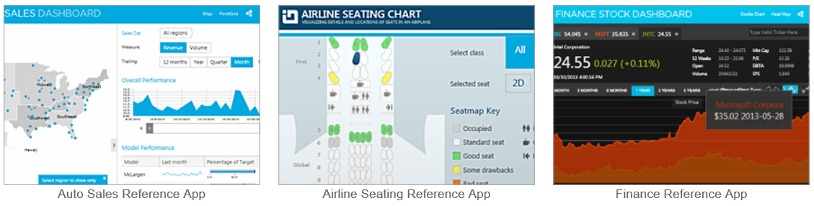
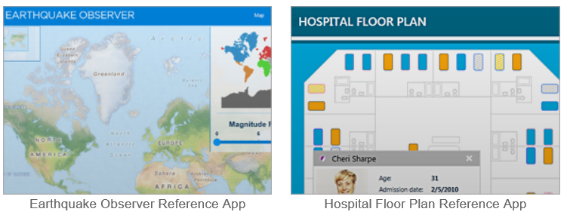
Infragistics
http://www.infragistics.com/products/wpf/

Slide 11
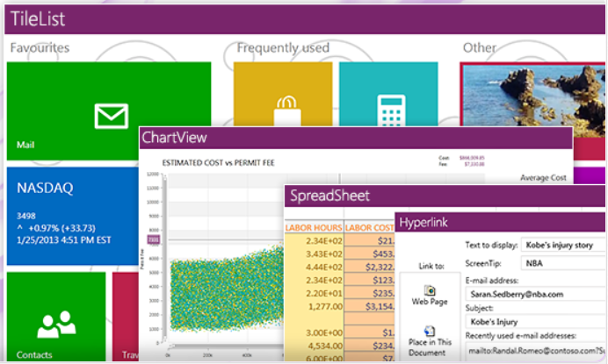
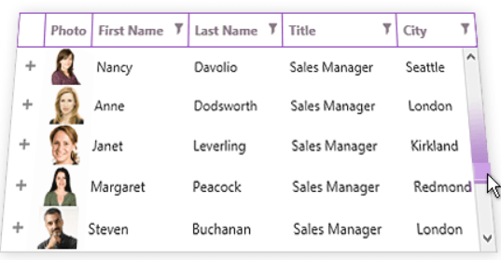
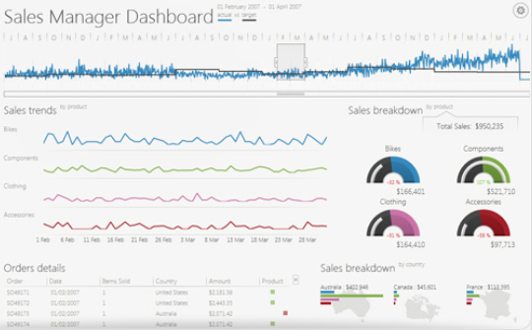
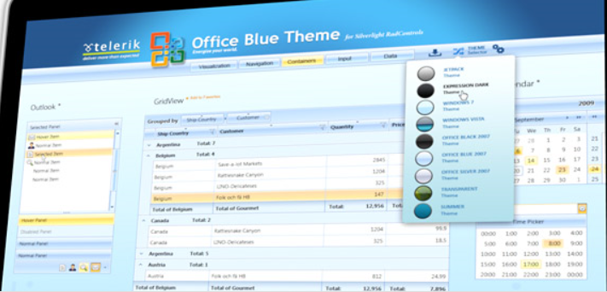
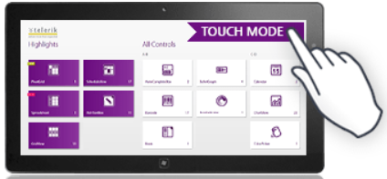
Telerik
http://www.telerik.com/products/wpf/overview.aspx

Slide 12
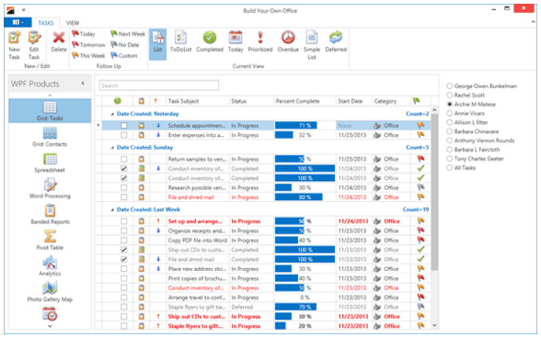
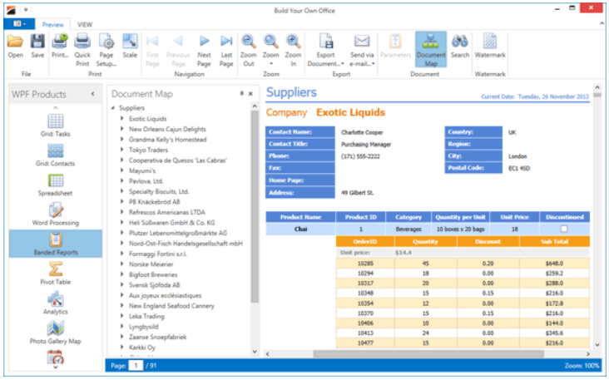
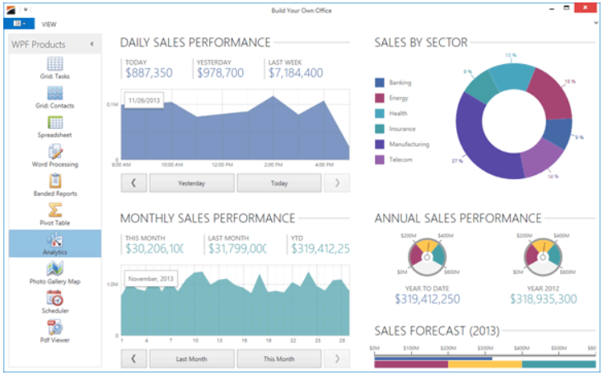
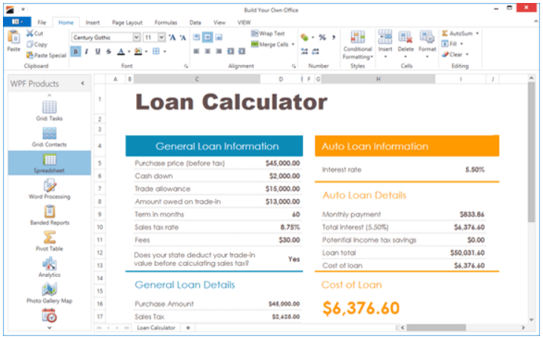
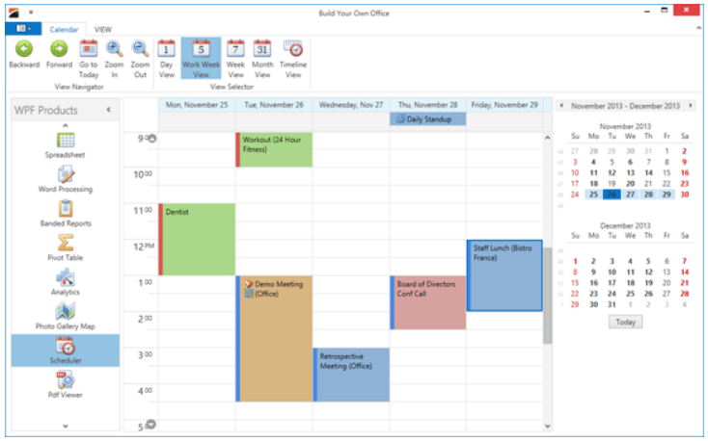
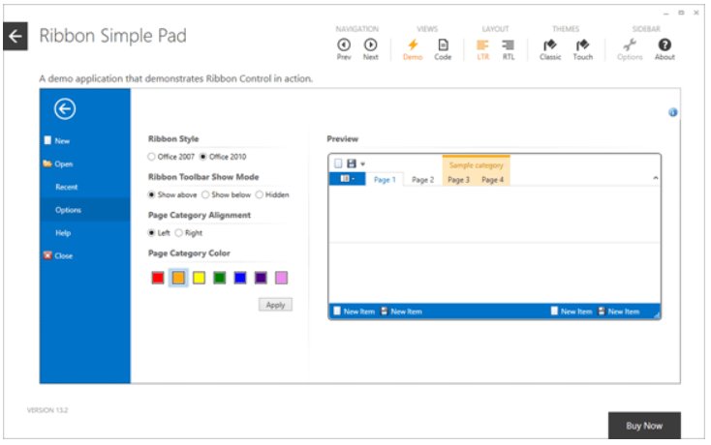
DevExpress
https://www.devexpress.com/Products/NET/Controls/WPF/

Slide 13
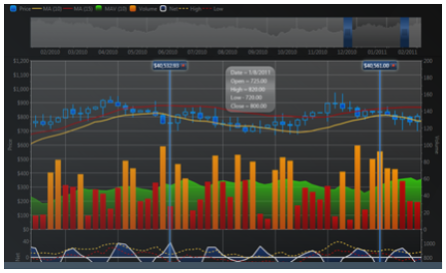
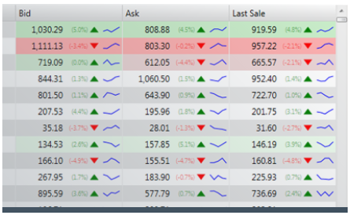
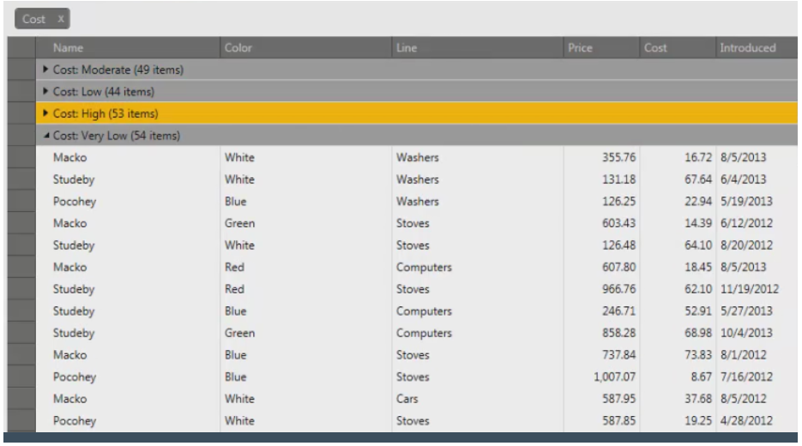
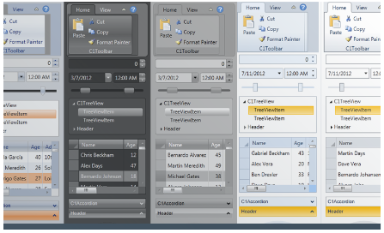
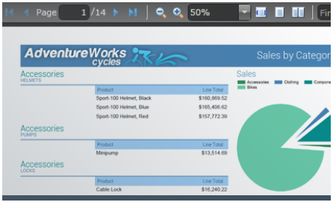
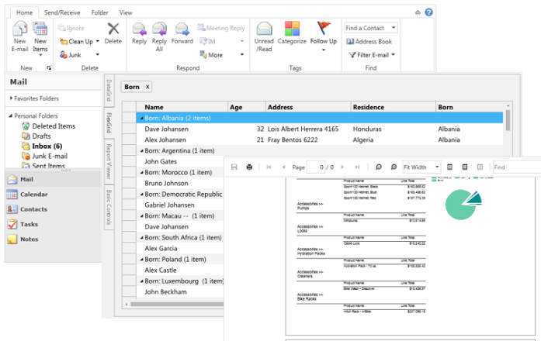
ComponentOne
http://www.componentone.com/SuperProducts/StudioWPF/

Slide 14
Summary
Modernize your platform
.NET & WPF improvements since 4.0
Modernize your tools
Visual Studio 2013
Modernize your user experience
Touch, toast, 3rd party controls

Slide 15
Resources
XAML Editor Improvements in Visual Studio 2013
http://blogs.msdn.com/b/visualstudio/archive/2013/08/09/xaml-editor-improvements-in-visual-studio-2013.aspx
Modernizing WPF Line-of-Business Applications
http://channel9.msdn.com/Events/TechEd/NorthAmerica/2013/DEV-B325#fbid=kt1W5OJuY58
DevExpress Controls for XAML Developers
http://channel9.msdn.com/Shows/Visual-Studio-Toolbox/DevExpress-Controls-for-XAML-Developers

Slide 16
Resources
Infragistics Controls for XAML Developers
http://channel9.msdn.com/Shows/Visual-Studio-Toolbox/Infragistics-Controls-for-XAML-Developers
Telerik Controls for XAML Developers
http://channel9.msdn.com/Shows/Visual-Studio-Toolbox/Telerik-Controls-for-XAML-Developers
ComponentOne Controls for XAML Developers
http://channel9.msdn.com/Shows/Visual-Studio-Toolbox/ComponentOne-Controls-for-XAML-Developers

Slide 17

© 2013 Microsoft Corporation. All rights reserved. Microsoft, Windows, Windows Vista and other product names are or may be registered trademarks and/or trademarks in the U.S. and/or other countries.
The information herein is for informational purposes only and represents the current view of Microsoft Corporation as of the date of this presentation. Because Microsoft must respond to changing market conditions, it should not be interpreted to be a commitment on the part of Microsoft, and Microsoft cannot guarantee the accuracy of any information provided after the date of this presentation. MICROSOFT MAKES NO WARRANTIES, EXPRESS, IMPLIED OR STATUTORY, AS TO THE INFORMATION IN THIS PRESENTATION.

